Slide 1
CS202: Programming Systems
Week 10 - Design Patterns
12/2022

Slide 2
Design Patterns
In software development, a design pattern is a general and reusable solution to a commonly occurring problem.
A design pattern can solve many problems by providing a framework for building an application.
With design patterns, the design process is cleaner and more efficient.
dbtien @ Programming Systems

Slide 3
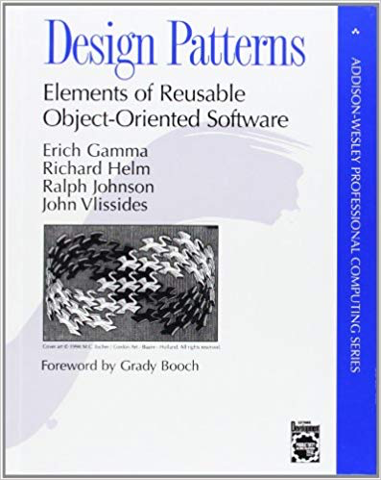
Book from the “Gang of Four”
23 patterns:

Slide 4
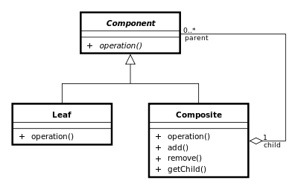
Composite Pattern
(from Wiki)
dbtien @ Programming Systems

Slide 5
Exercise
Design and implement the File&Folder structure using the Composite Pattern
dbtien @ Programming Systems

Slide 6
Design pattern: Singleton
The singleton pattern is a design pattern used to restrict the instantiation of a class to only one object.
It is very useful when exactly one object is needed for the system.
dbtien @ Programming Systems

Slide 7
Singleton
class Singleton {
public:
static Singleton* Instance() {
if (!singleton) singleton = new Singleton;
return singleton;
}
private:
static Singleton* singleton;
Singleton() {};
Singleton(const Singleton&);// prevent copy-construction
Singleton& operator=(const Singleton&); //prevent =
};
Singleton* singleton = nullptr;
dbtien @ Programming Systems

Slide 8
Singleton: attempt to delete?!
int main() {
Singleton* pS = new Singleton;
//...
delete pS;
//...
return 0;
}
Attempt to delete it?!
dbtien @ Programming Systems

Slide 9
Singleton: avoid the deletion
class Singleton {
public:
static Singleton& Instance() {
if (!singleton) singleton = new Singleton;
return *singleton;
}
private:
static Singleton* singleton;
Singleton() {};
Singleton(const Singleton&);// prevent copy-construction
Singleton& operator=(const Singleton&); //prevent =
};
Singleton* singleton = nullptr;
Return a reference
dbtien @ Programming Systems

Slide 10
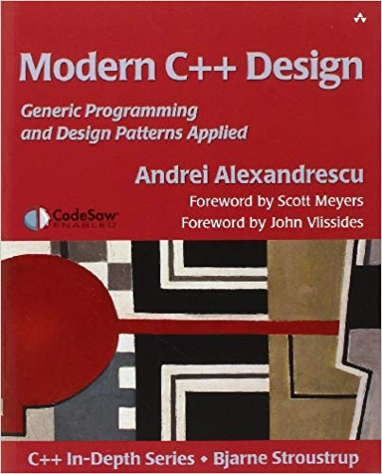
Design pattern: Singleton (cont.)
Still, there are several problems that we need to consider carefully when we implement the Singleton Pattern:
  When and how to destroy the Singleton?
  How can we ensure it will be de-allocated lastly comparing to other objects?
  Multi-processing/multi-threading
Reference: Modern C++ Design, chapter 6.
dbtien @ Programming Systems

Slide 11
Singleton: Meyers singleton
class Singleton {
public:
static Singleton& Instance() {
static Singleton singleton;
return singleton;
}
private:
Singleton() {};
Singleton(const Singleton&);// prevent copy-construction
Singleton& operator=(const Singleton&); //prevent =
};
dbtien @ Programming Systems

